Slide 1
Software Maintenance Cost Estimation and Models

Slide 2
Software Maintenance Cost Estimation
Expense associated with updating, repairing, and enhancing software after its initial deployment. This includes:
bug fixes,
performance improvements
security updates
adapting the software to new hardware or operating systems.
Understanding these costs is crucial for ensuring the long-term functionality and reliability of software solutions while managing budget allocations effectively.

Slide 3
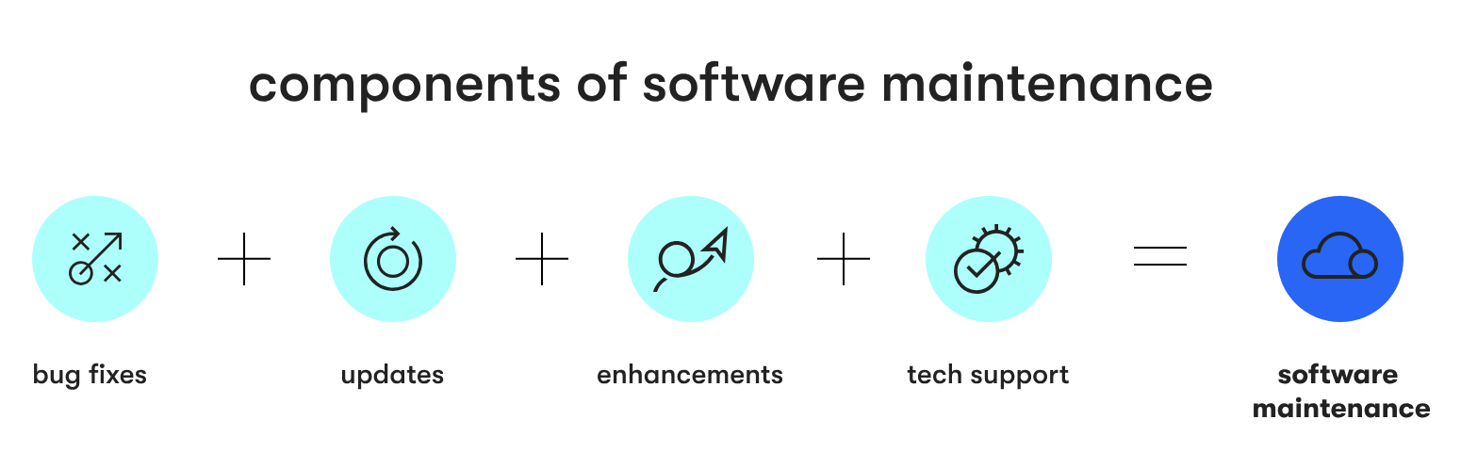
Components of Software Maintenance
B+U+E+TS = BUETS = Software Maintenance

Slide 4
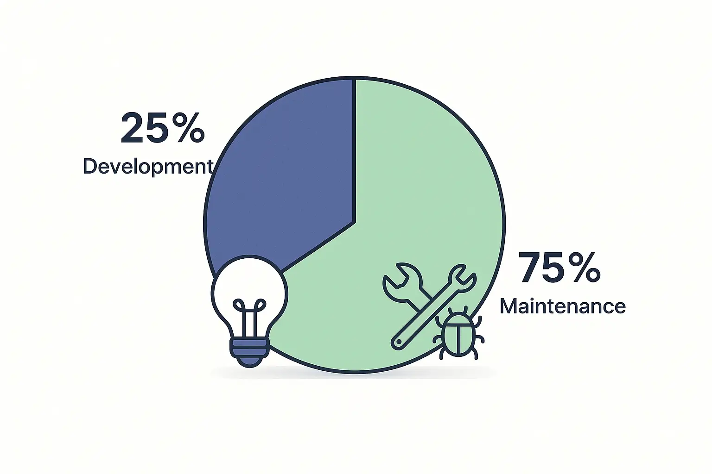
Maintenance Cost

Slide 5
Why the maintenance-to-development ratio matters
The ratio between maintenance costs and development costs serves as a critical indicator of software quality and sustainability.
Abnormally high maintenance costs relative to initial development often indicate:
Poor initial architecture decisions
Inadequate testing during development
Excessive technical debt
Insufficient documentation
Overly complex or custom solutions when simpler options would suffice
These issues don't just impact your budget - they affect your ability to remain competitive and responsive to market changes.
When excessive resources go toward maintaining existing functionality, fewer resources remain available for innovation and growth.

Slide 6
Software maintenance cost percentage distribution
Maintenance costs typically distribute across the four maintenance types as follows:
Corrective maintenance: 20-30% (Newer ones)
Adaptive maintenance: 20-25% (Mature ones)
Perfective maintenance: 30-40%
Preventive maintenance: 10-20%
This distribution varies based on software type, age, and organizational priorities.
Mature software may require more adaptive maintenance to remain relevant
while newer software often demands more corrective maintenance to address early-life bugs.

Slide 7
Software maintenance cost percentage distribution
The maintenance budget also changes over the software's lifecycle. Gartner's research suggests maintenance costs follow a predictable pattern:
Early phase (years 1-2): 10-25% of development costs annually
Mid-life phase (years 3-5): 15-30% of development costs annually
Mature phase (years 6+): 20-40% of development costs annually
This escalating pattern reinforces why lifetime cost projections are essential for accurate budgeting and financial planning.

Slide 8
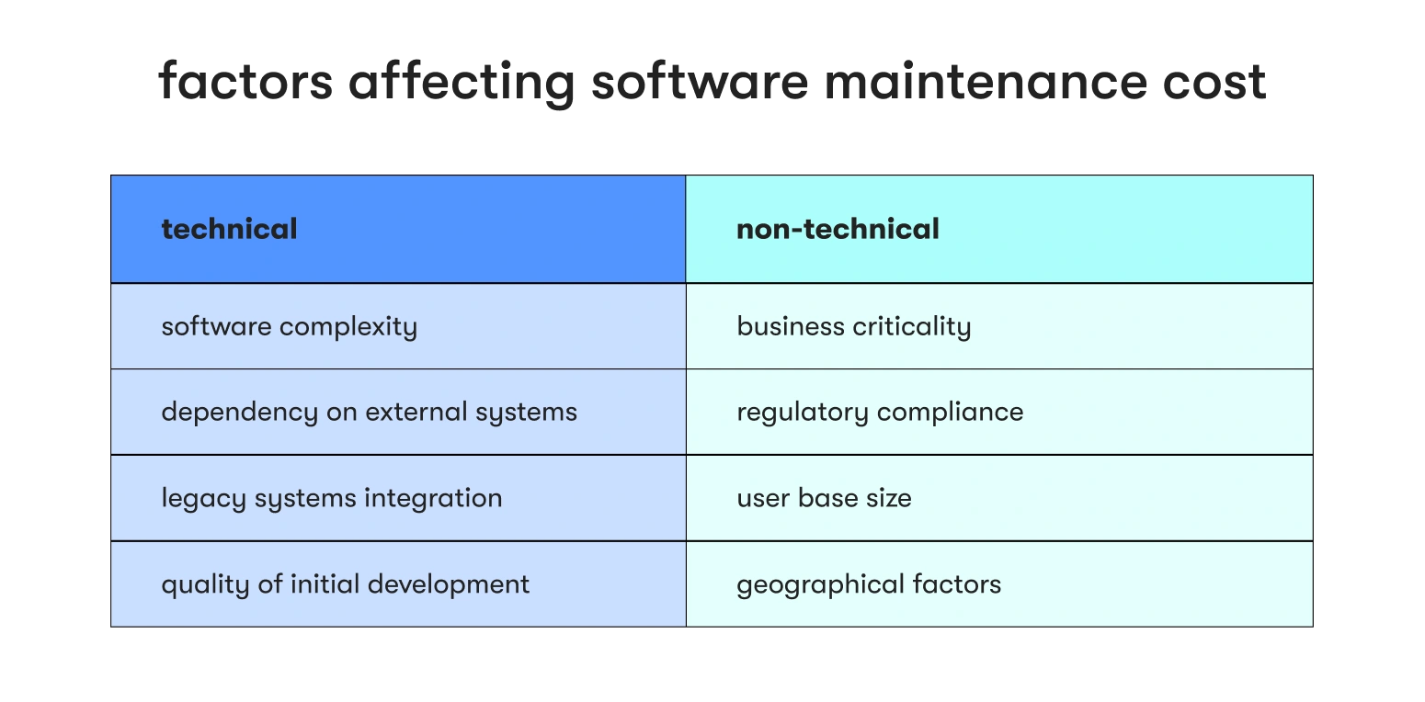
Factors Affecting Software Maintenance Cost

Slide 9
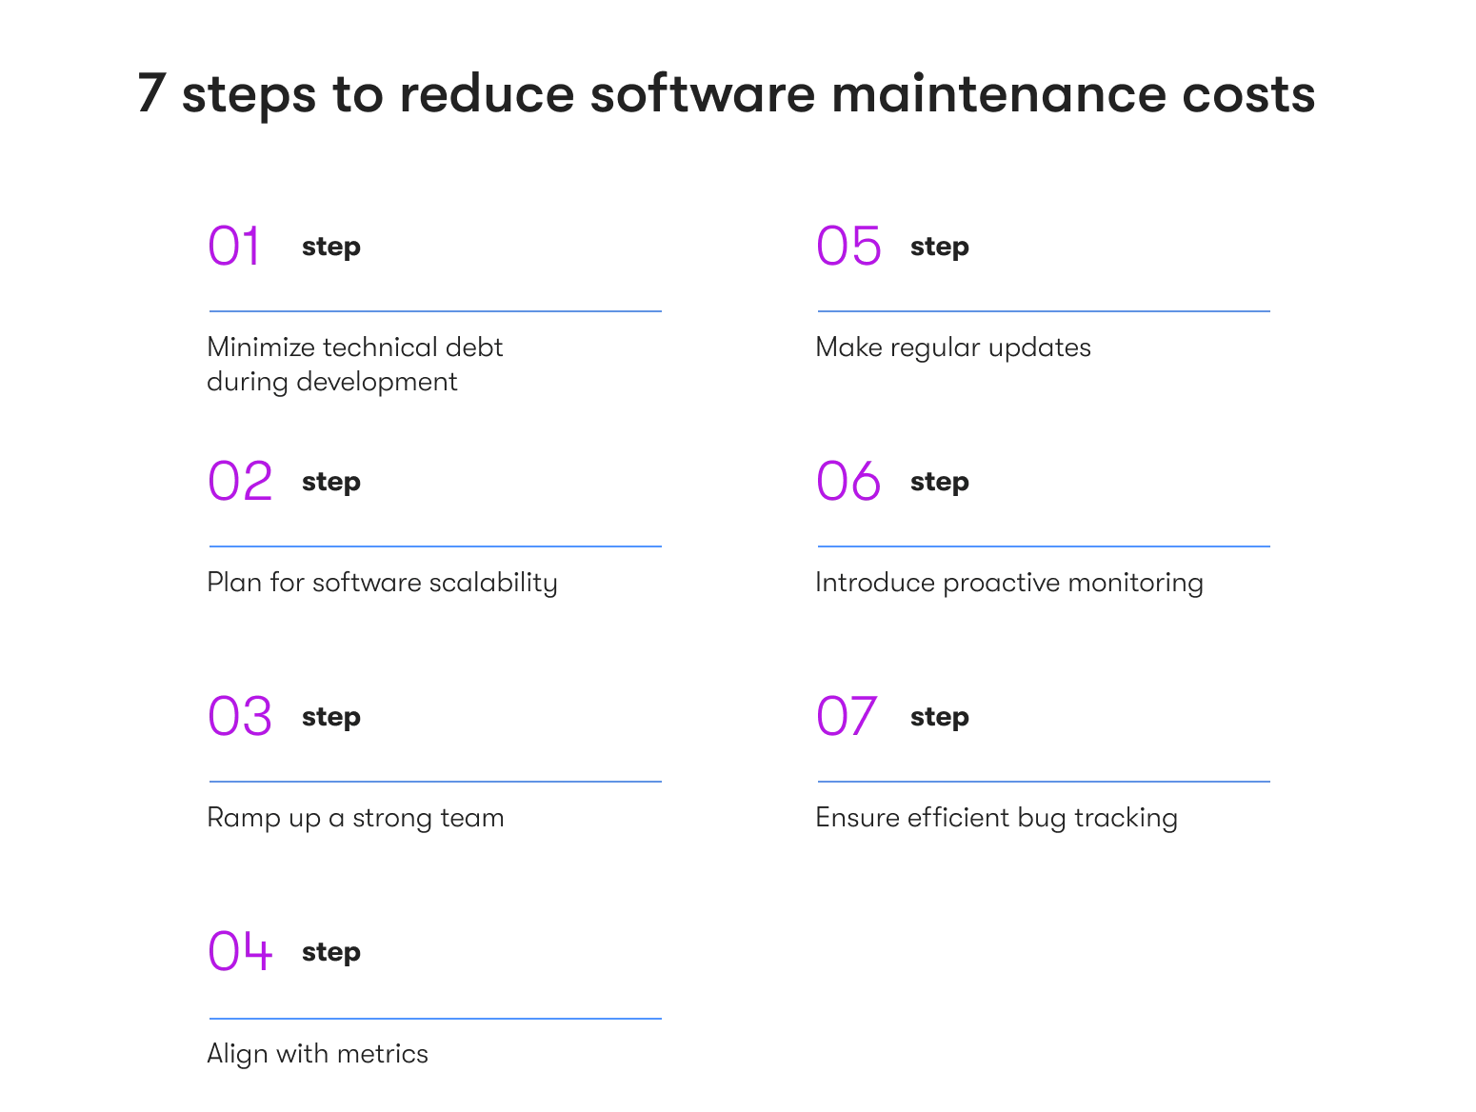
Steps to Reduce Maintenance Cost

Slide 10
Cost analysis Methodologies for software Projects
Total Cost of Ownership (TCO) analysis
Function Point Analysis (FPA)
Constructive Cost Model (COCOMO)
Value-based analysis

Slide 11
Total Cost of Ownership (TCO) analysis
TCO analysis examines all direct and indirect costs associated with software throughout its lifecycle. This includes:
Initial acquisition/development costs
Implementation and integration costs
Ongoing maintenance and support
Infrastructure and hosting fees
Training and user support
Opportunity costs of deployment
Eventual replacement or decommissioning costs
This approach prevents the common mistake of focusing exclusively on upfront development expenses while ignoring the more significant long-term costs.

Slide 12
Function Point Analysis (FPA)
Function Point Analysis measures software size based on functionality rather than technical complexity. This method:
Evaluates software from the user's perspective
Provides a standardized measurement approach
Enables more accurate estimates for both development and maintenance
Facilitates comparisons across different technologies
FPA helps organizations predict maintenance efforts more accurately by establishing a clearer relationship between functional complexity and maintenance requirements.

Slide 13
Constructive Cost Model (COCOMO)
COCOMO provides algorithmic software cost estimation models that incorporate:
Project size (in lines of code or function points)
Development methodology
Team expertise
Technical complexity factors
Required reliability
Modern variations like COCOMO II include parameters that help predict maintenance costs based on the development approach and environmental factors.

Slide 14
Value-based analysis
Beyond pure cost considerations, value-based approaches assess whether software delivers sufficient business value to justify its total cost. This analysis includes:
Revenue generation potential
Operational efficiency improvements
Competitive advantage creation
Customer satisfaction impact
Risk reduction benefits
This approach recognizes that higher-cost software may still represent a better investment if it delivers proportionally greater value.

Slide 15
Case study 1: The banking system migration
A mid-sized bank invested $5 million in developing a new core banking system. The development team delivered on time and within budget, winning executive praise. However, within three years, annual maintenance costs reached $2.1 million - over 40% of the original development cost. Issues included:
Legacy data integration complications requiring ongoing specialized support
Regulatory changes necessitating frequent updates
Performance optimization for growing transaction volumes
Security patching against evolving threats
Lessons learned: The bank had budgeted for only 15% annual maintenance, creating significant financial strain. If they conducted proper TCO analysis, they would have anticipated these costs and either adjusted their approach or prepared adequate reserves.

Slide 16
Case study 2: The startup's technical debt crisis
A promising startup built their product rapidly to meet investor milestones, accumulating significant technical debt. Their initial development cost $400,000 and delivered an MVP that attracted users and additional funding. However, by year three:
Bug fixing consumed 35% of developer time
Adding new features took 3x longer than projected
System stability issues created customer satisfaction problems
Developer turnover increased as team members became frustrated with the maintenance burden
The company eventually spent $900,000 on a partial rewrite - more than twice the original development cost - to address fundamental architectural issues.
Lessons learned: Short-term development savings created massive maintenance penalties. Proper preventive maintenance and better initial architecture would have cost more upfront but saved millions over time.

Slide 17
Case study 3: The balanced approach success story
A healthcare software company developing a patient management system took a balanced approach:
Initial development budget: $1.2 million
Annual maintenance budget: $300,000-$400,000 (25-33% of development)
Dedicated 20% of developer time to technical debt reduction and code quality
Invested in comprehensive automated testing infrastructure
Maintained detailed documentation and knowledge management
Five years later, their maintenance costs remained stable at around 25% of initial development annually, while competitors struggled with escalating maintenance burdens reaching 40-50% of development costs.
Lessons learned: Deliberate planning for maintenance from the project's inception resulted in lower total cost of ownership and greater business agility.

Slide 18
The key takeaways for businesses
Budget for the full software lifecycle, not just development
Expect maintenance to cost 2-4 times the initial development over the software's lifetime
Invest in quality, documentation, and testing during development
Allocate resources to all four types of maintenance, including preventive
Track maintenance costs and compare them to value delivered
Use comprehensive cost analysis methodologies for better decision-making

Slide 19
References
https://www.geeksforgeeks.org/software-engineering/cost-and-efforts-of-software-maintenance/
https://startups.epam.com/blog/software-maintenance-cost
https://idealink.tech/blog/software-development-maintenance-true-cost-equation

